Slide 1

Partition clustering Gaussian process for multi-source domain adaptation
Kai Yang
Supervisor: Jie Lu
Co-Supervisor: Guangquan Zhang
Centre for Artificial Intelligence, FEIT, UTS

Slide 2

Outline
Kai Yang, CAI, FEIT
Problem statement
Gaussian process
Partition clustering
Combination rule
Multi-source domain
Heterogeneous
Notes:
Here is the outline.

Slide 3

What is Transfer Learning?
Transfer learning mimics the human learning process, it borrows data from a similar area of knowledge as a possible solution for solving problems when there is a shortage of data in the target domain.
Notes:
The first question: what is transfer learning. …

Slide 4

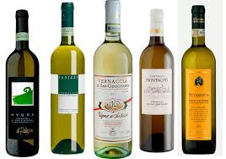


What is Transfer Learning?
Homogenous
Red wine
White wine
Heterogeneous
House in China
House in Australia
Notes:
Component recipe
element

Slide 5
Problem statement
Multi-source domain adaptation for regression problem
Domain , source domains , target domain .
Task
The values of task are continuous.
Homogenous problem
or
Supervised learning
The multiple source domains have sufficient labeled data, the target domain has few labeled data
Notes:
In the research view， x is the feature space, p(x) is the function distribution or the marginal probability distribution, y is the label space,

Slide 6
Gaussian process
Definition of Gaussian process (GP)
A GP is a collection of random variables, where any finite number of these variables have consistent joint Gaussian distributions.
m is the mean function, k is the covariance function.
prior
posterior
Notes:
We focus on the regression problem, GP is very suitable for regression problem,

Slide 7
Adaptive Gaussian process
We develop the adaptive GP transfer model, the joint distribution in the GP for the source domain and the target domain is
The new transfer kernel is
Notes:
Less than or equal to, in order to satisfy the positive semi-definite matrix

Slide 8
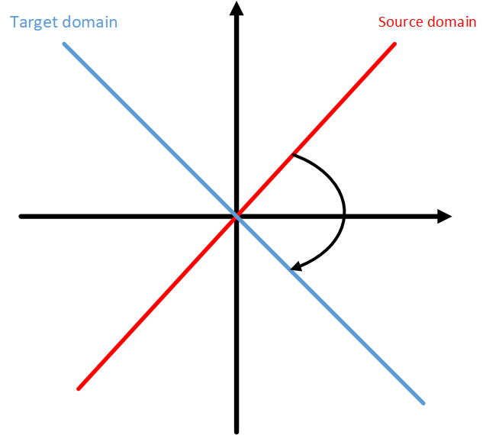
Adaptive Gaussian process
The conditional probability as the objective function to optimize the target domain.
Transfer range
Notes:
Gaussian process is a nonparametric method, based on Bayes theory, which uses probability as a way to describe the function distribution. these models provide a convenient approach to flexible non-linear regression tasks.

Slide 9
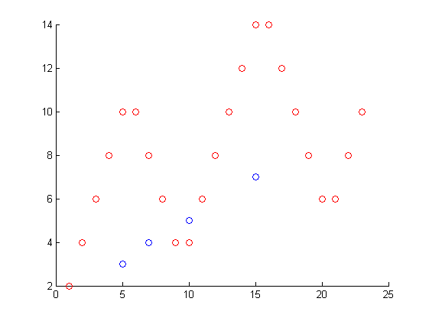
Partition clustering
Partition rule
Each part of clustering has the approximate linear relationship for the source domain and the target domain.
Source domain clustering
For the source domain data to find the nearest target data.
S :------
T :----

Slide 10
Partition clustering
Target domain clustering
Difference of the target domain and the source domain combine the new datasets.
Select d+2 data to fit the linear function

Slide 11
Partition clustering
Clustering rule
The partial derivatives function of linear function whether have the same symbol
Positive
Cross
Negative

Slide 12
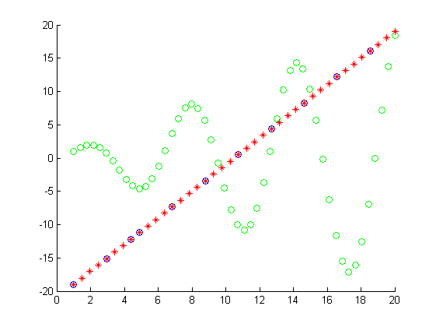
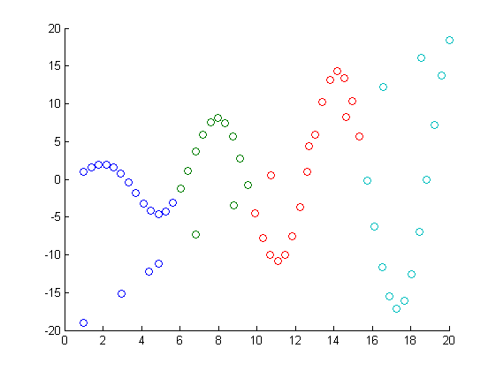
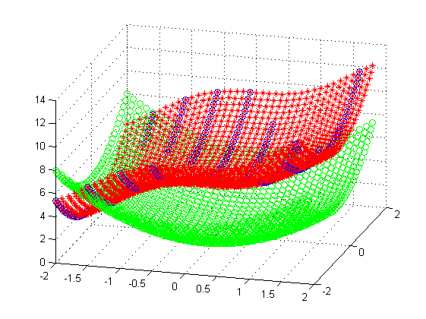
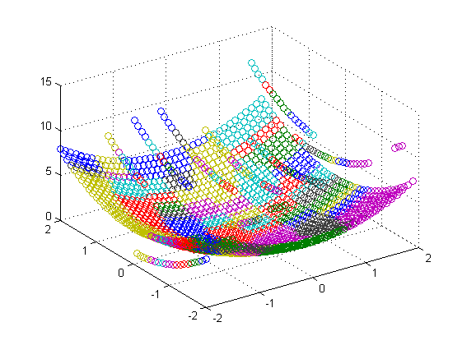
Partition clustering
S :------
T :----
S :------
T :----

Slide 13
Multi-source domain
For the multi-source domain, we use the ensemble strategy to stacking all the source domains’ knowledge
Or choose the best source domain to transfer would be better?

Slide 14
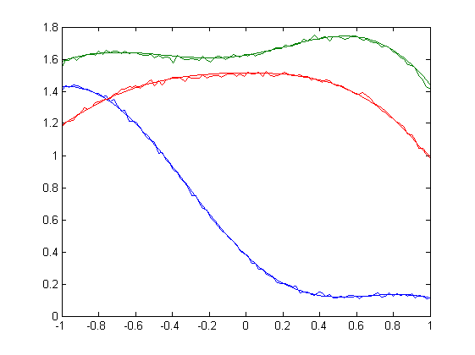
Multi-source domain
Combine all the source domains
S1 :------
S2:------
T :-------

Slide 15
THANK YOU!
Q & A

